Slide 1


Embedded programing course
IoT-TLU Laboratory

Slide 2
Handling analog input
Lab #6: Temperature Sensor
Lab #7: Moisture Sensing
Lab #8: Light Sensor

Slide 3
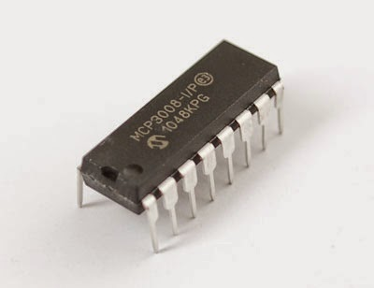
Analog-to-Digital (ADC)
The Raspberry Pi has no built in analogue inputs which means it is a bit of a pain to use many of the available sensors
The MCP3008 is a 10bit 8-channel Analogue-to-digital converter (ADC). It is cheap, easy to connect and doesn’t require any additional components. It uses the SPI bus protocol which is supported by the Pi’s GPIO header

Slide 4
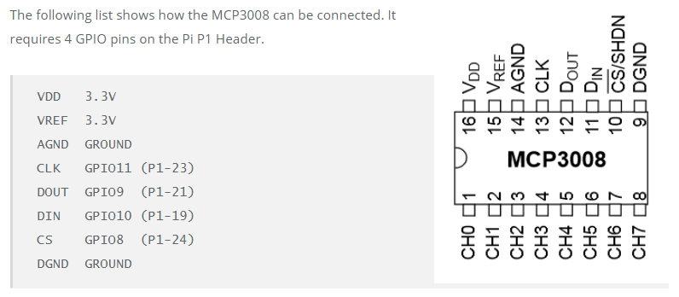
How to connect MCP3008?
Double check before connecting to power supply and coding

Slide 5
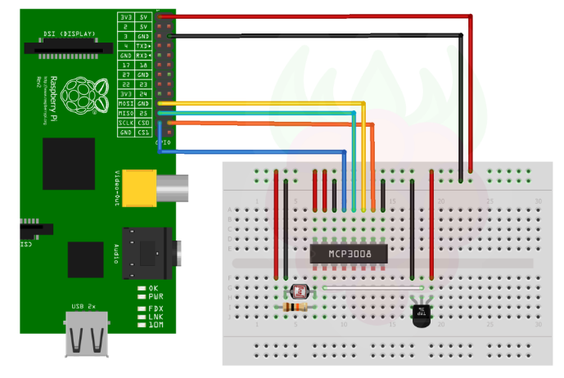
How to connect MCP3008?

Slide 6
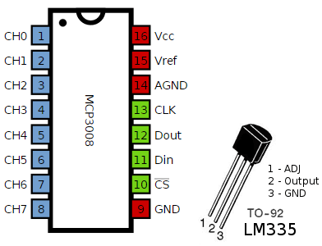
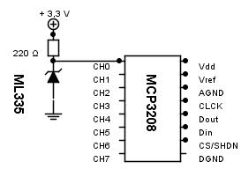
Temperature Sensor – LM335
2
3

Slide 7
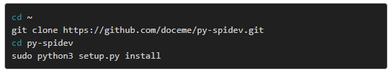
Installing the library “spidev”

Slide 8
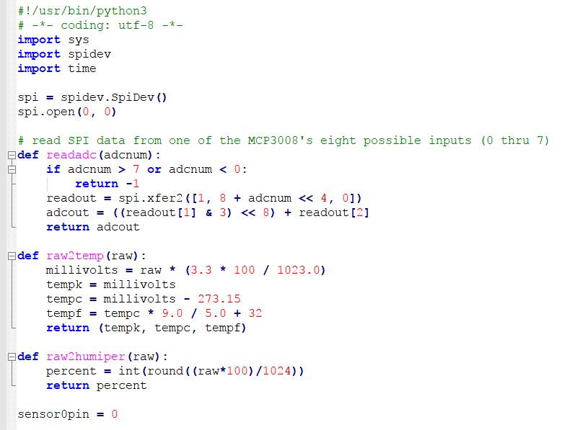
Programming
Create the following program mcp3008.py:

Slide 9
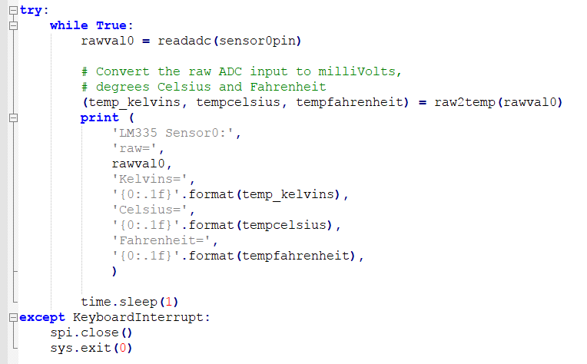
Programming
Create the following program mcp3008.py:

Slide 10
Handling analog input
Lab #6: Temperature Sensor
Lab #7: Moisture Sensing
Lab #8: Light Sensor

Slide 11
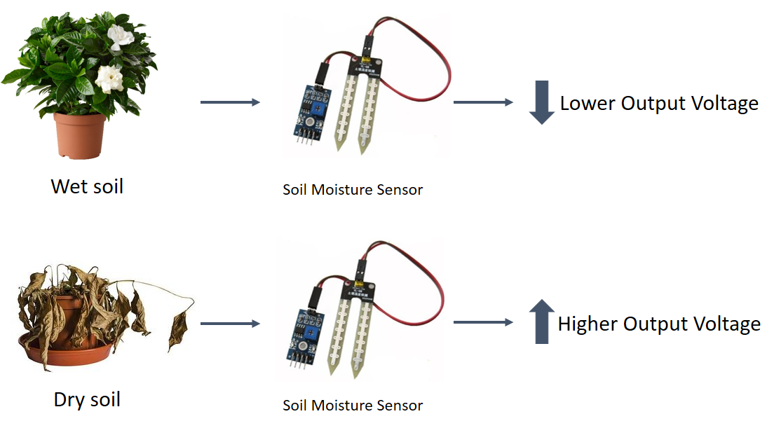
Moisture Sensor

Slide 12
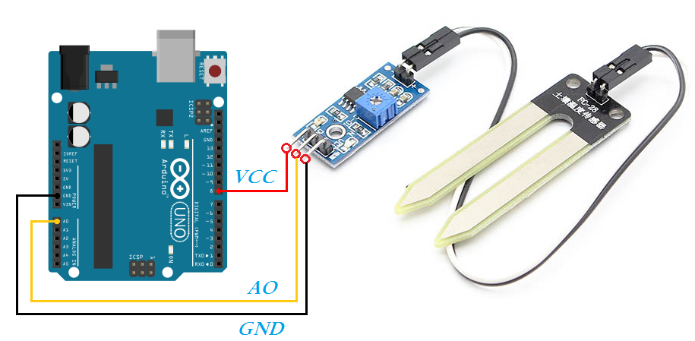
Moisture Sensor – Assignment 3
Try to modify file mcp3008.py to measure moisture

Slide 13
Display on LCD – Assignment 4
Try to display temperature and moisture information on the LCD 16x2

Slide 14
Handling analog input
Lab #6: Temperature Sensor
Lab #7: Moisture Sensing
Lab #8: Light Sensor

Slide 15
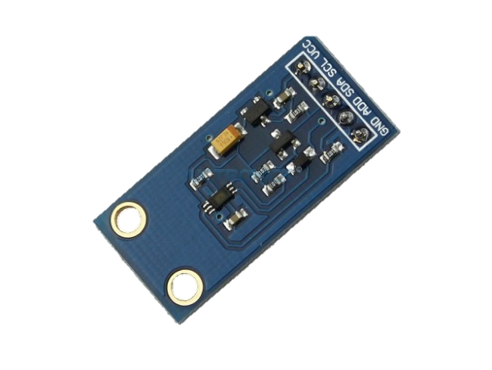
Light Intensity Sensor - BH1750
TheBH1750FVI device is a digital light intensity sensor which uses the I2C interface. This allows it to be connected to the Raspberry Pi with only four wires

Slide 16
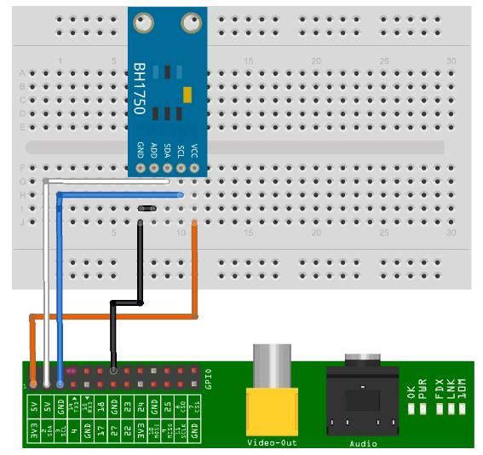
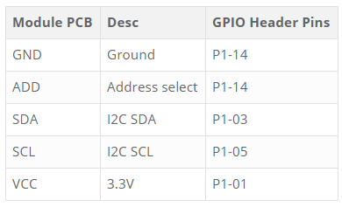
Connecting Hardware

Slide 17
Getting the program
Run command “wget https://bitbucket.org/MattHawkinsUK/rpispy-misc/raw/master/python/bh1750.py

Slide 18
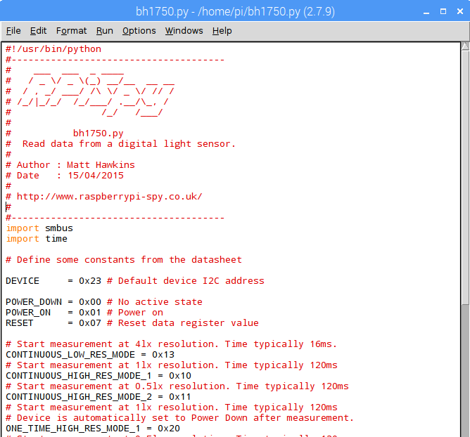
Running the program
Open file “bh1750.py” from Python Shell

